Slide 1
Control Valve with Floating Seal
Solution to
Fouling and Failures
Common in Spool Valves

Slide 2
Content
The Company
  Moretz Technologies,. LLC
  Rotary Valve Systems (RVS)
  Rotary Valve Technologies (RVT)
The Technologies
  The Concept
    Existing Systems
    RVT System
The Applications
  Engine Variable Valve Timing Control
  Hydraulic System
    Pressure Regulator
    Hydraulic Control

Slide 3
PROBLEM
Spool Valves are frequently utilized to control and direct fluid flow In automotive applications such as transmissions and variable valve timing devices. These valves, because of the very tight clearances between the spool and the cylinder, are prone to failure resulting from tiny bits of contaminants being caught between the spool and cylinder. This results in considerable warranty costs and customer dissatisfaction.

Slide 4
This problem is particularly troublesome in variable valve timing devices, as engine oil is considerably less clean than transmission fluid.
The “floating seal” valve presented here eliminates contamination-caused failures.

Slide 5
The following slides show the typical “Body” portion of the floating seal concept, a typical “Cover” portion designed for rotary operation, and a typical “Cover” portion designed for axial operation of the valve.

Slide 6
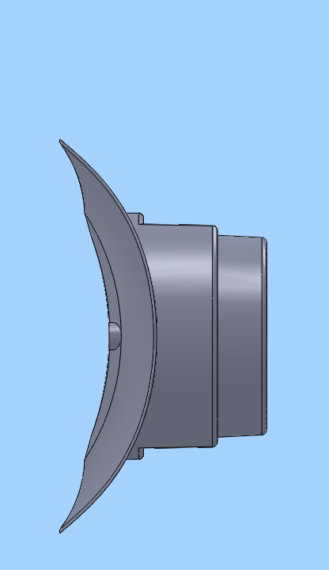
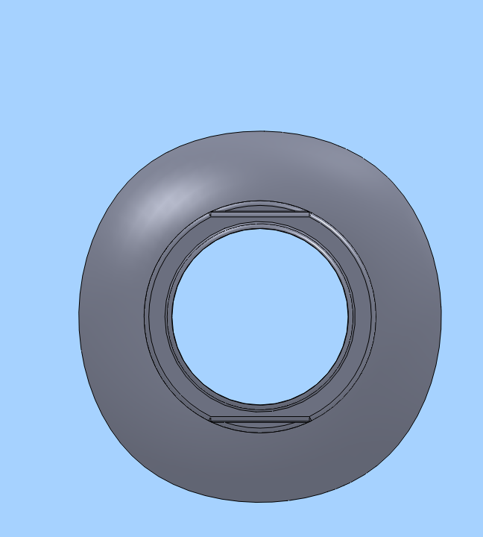
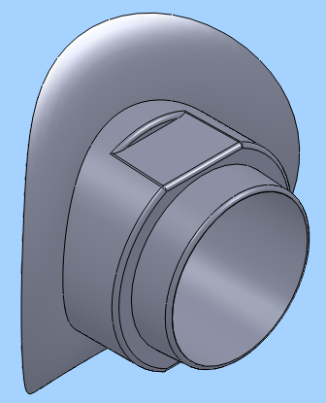

Slide 7
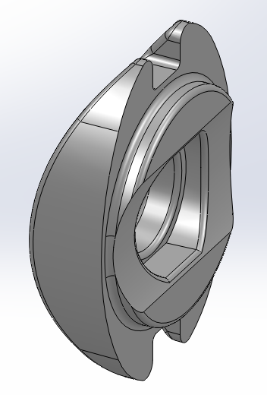
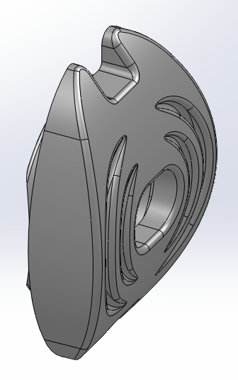
Original Rotary Valve Cover

Slide 8
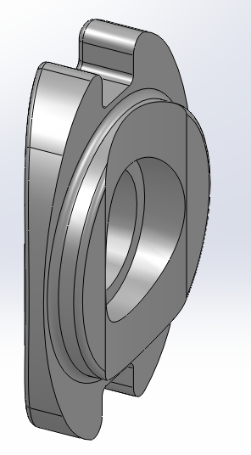
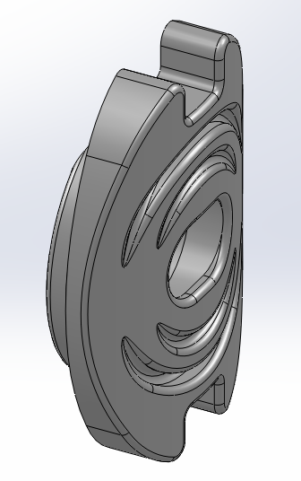
Linear Motion Cover

Slide 9
The “floating seal” concept utilizes a balancing of pressures on both sides of the seal assembly to allow contaminants to flush through the valve, and the valve sealing face to ride over particulates with little or no resistance.

Slide 10
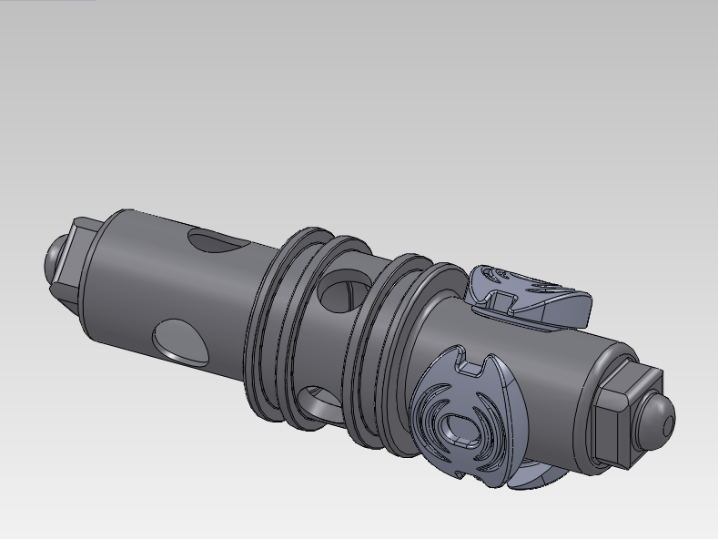
Initial Phaser Valve Design
Three Inserts per Valve
O-ring Grooves
Three Insert (min.)
Phased Ports

Slide 11
When the force provided by the actuating solenoid is limited, for axial operation, and when desirable for rotary operation, in order to minimize friction, the o-ring grooves are equipped with overlapping polymer rings, roughly analogous to piston rings. Testing has shown that the sealing is quite good, and friction is minimal.

Slide 12
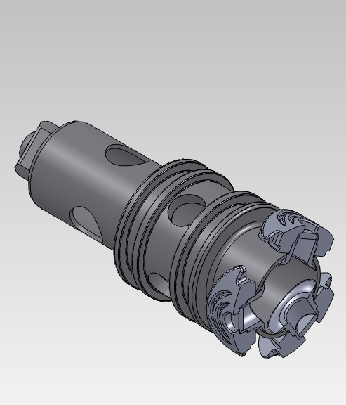
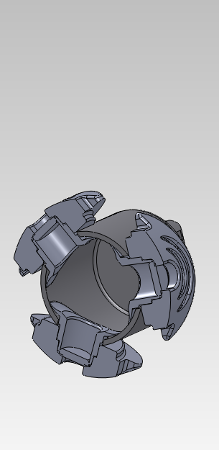
Section Through Inserts

Slide 13
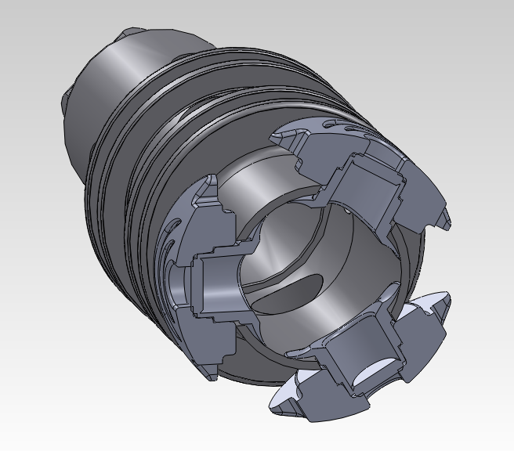
Section of Valve designed for VVT Control showing floating seals installed

Slide 14
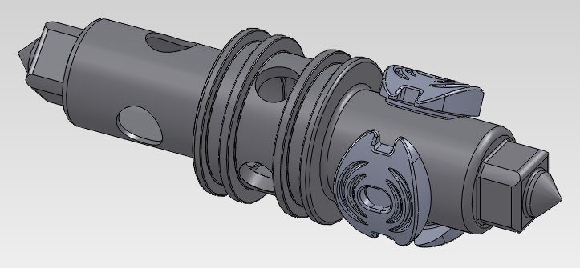
Rotary Valve (Designed for VVT Control)

Slide 15
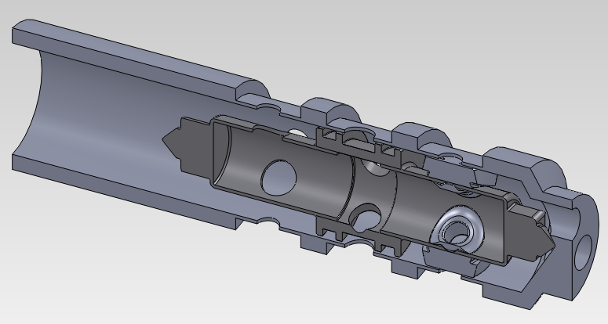
Rotary Valve shown in VVT Control Valve Body

Slide 16
Transparency
The previous illustration shows the valve installed in a currently-used VVT control valve housing. The solenoid used would be one that would provide complete transparency on the assembly line and in service, eliminating the risks often faced in changes to current systems. This valve would be completely interchangeable with the current valve.

Slide 18
Moretz Technologies, LLC
807 Airport Road P. O. Box 4031 Jackson, MI 49204
517-780-4002 M 517-206-3287 FAX 517-780-0950
rdale@moretz.com
Moretz Technologies is in the process of becoming certified as a veteran-owned business.

